Slide 1
Image classification using Convolutional neural network (CIFAR 10 dataset)
My objective is to design a convolutional neural network, train a model and evaluate the model's ability to produce the desired or intended result.

Slide 2
Focus area:
Focus Areas
1. Convolutional Neural Networks
2. Data augmentation
3. Fine-tuning pre-trained models.

Slide 3
Convolutional neural network (CNN)
What are Convolutional neural network (CNN)
CNN architecture and layers

Slide 4
Convolutional Neural network (CNN)
Convolutional Neural networks are a type of deep learning algorithm designed to process and analyze visual data.
CNN Consists of :
1.Convolutional layers
2.Pooling layers
3.Fully connected layers
CNN Recognize patterns in image data

Slide 5
Convolutional Neural network architectures
LeNet -5
ResNet
AlexNet
VGGNet
GoogleNet

Slide 6
LeNet -5 Architecture
Designed by Yann lecun in the 1990s
Consists of five layers :
Input layer
Convolutional layers
Pooling layers
Fully connected layers

Slide 7
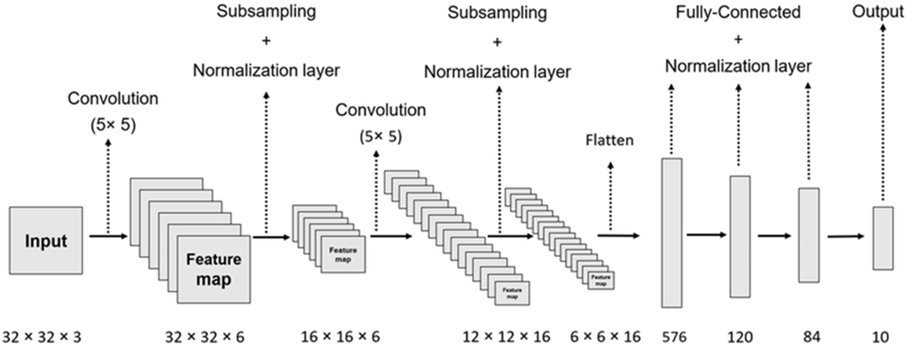
Mechanism of LeNet -5 convolutional neural network architecture
Basic architecture of LeNet-5

Slide 8
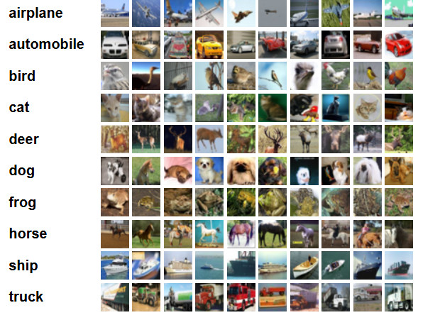
The CIFAR-10 dataset Showing 10 random images from each of the 10 classes

Slide 9
Dimension of Training, Testing and Validation sets
Training sets (50000, 32, 32, 3)
Test sets (10000, 32, 32, 3)
Validation sets(10000, 32, 32, 3)

Slide 10
Image classification with CIFAR 10 dataset using Convolutional neural network architecture
The primary aim of image classification with the CIFAR-10 dataset using CNNs is to arrange (categorize) the images into one of the ten predefined classes accurately (e.g., airplane, automobile, bird, cat, etc.).

Slide 11
The feature map
Formation of the Features in the feature map.

Slide 12
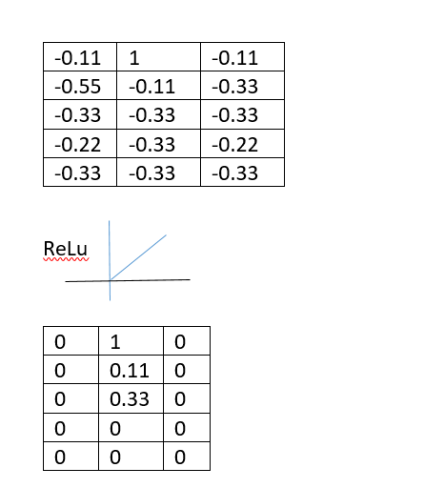
Activation functions
ReLu

Slide 13
The Pooling Layer
1. Max pooling layer
2. Average pooling layer

Slide 14
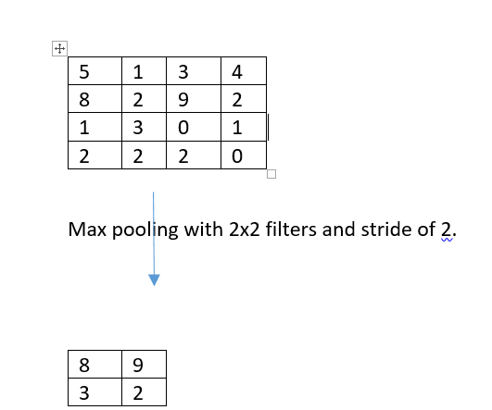
Max Pooling

Slide 15
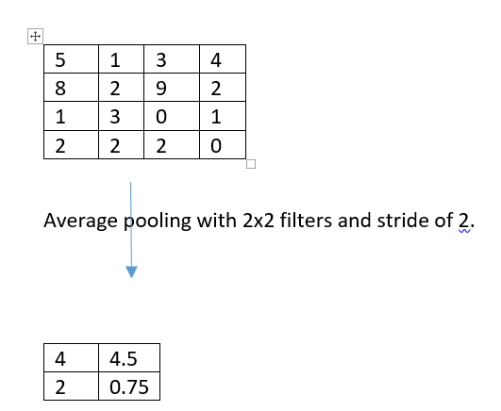
Average Pooling

Slide 16
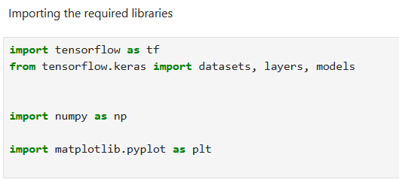
Codes

Slide 17
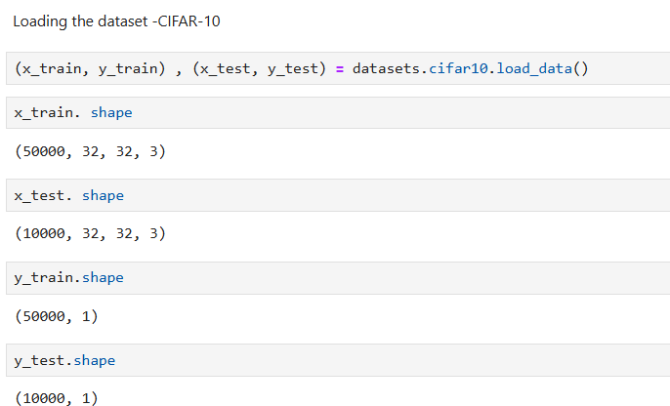

Slide 18
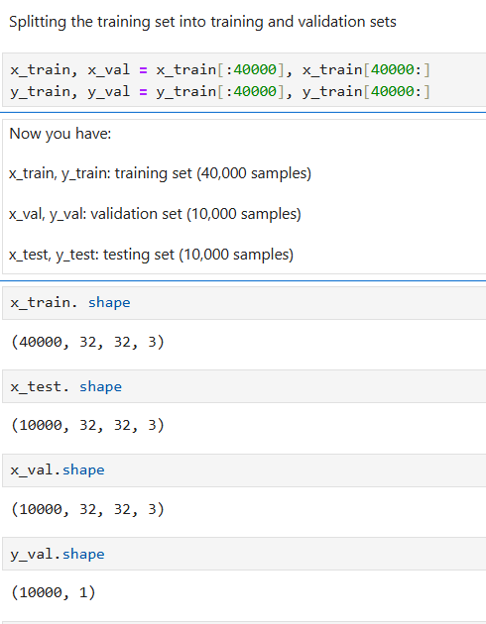

Slide 19
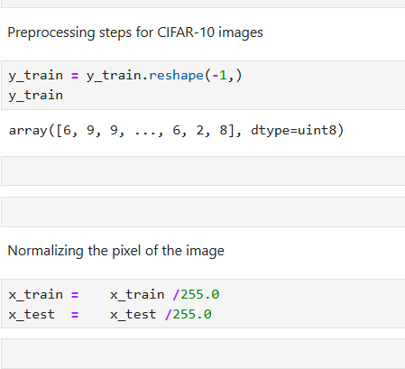

Slide 20
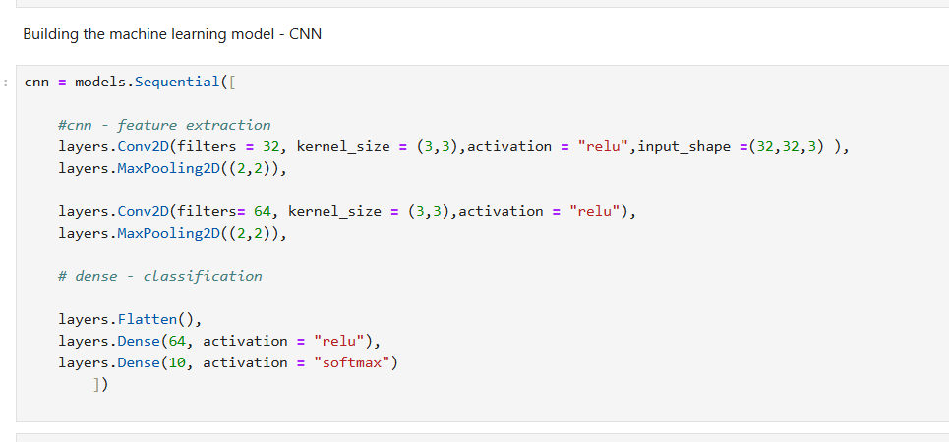

Slide 21
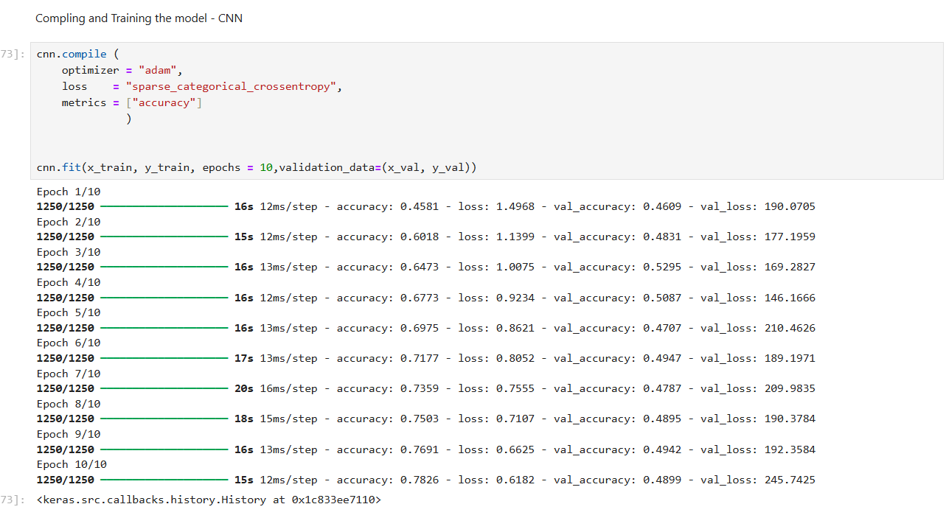

Slide 22
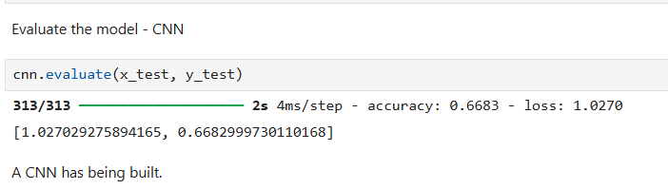

Slide 23
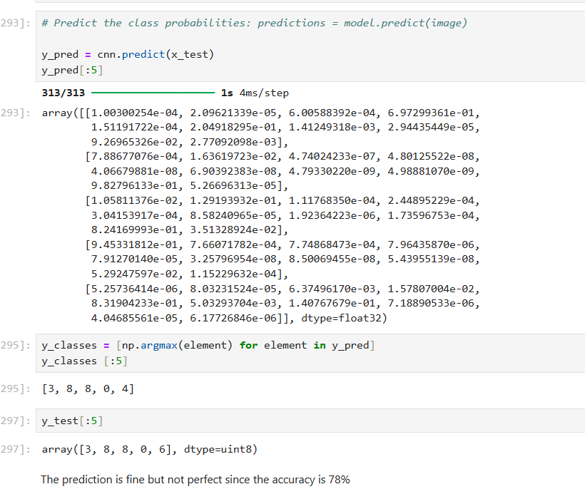

Slide 24
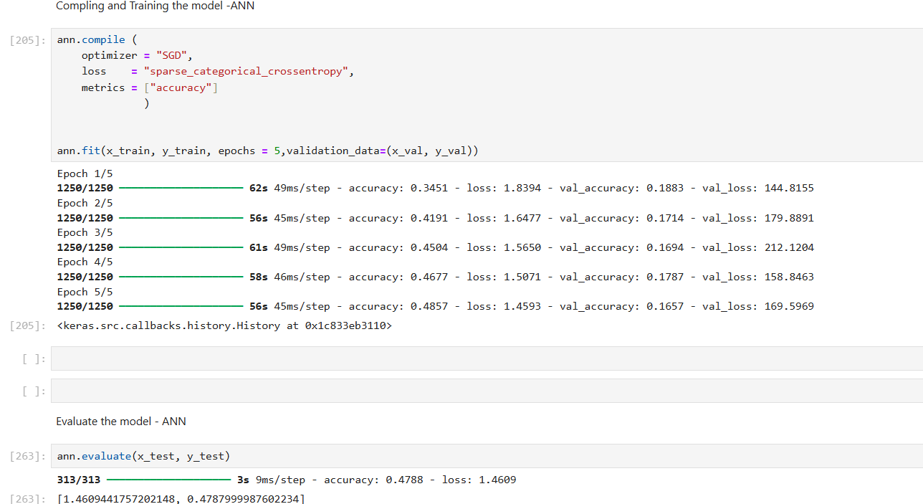
Accuracy without CNN

Slide 25
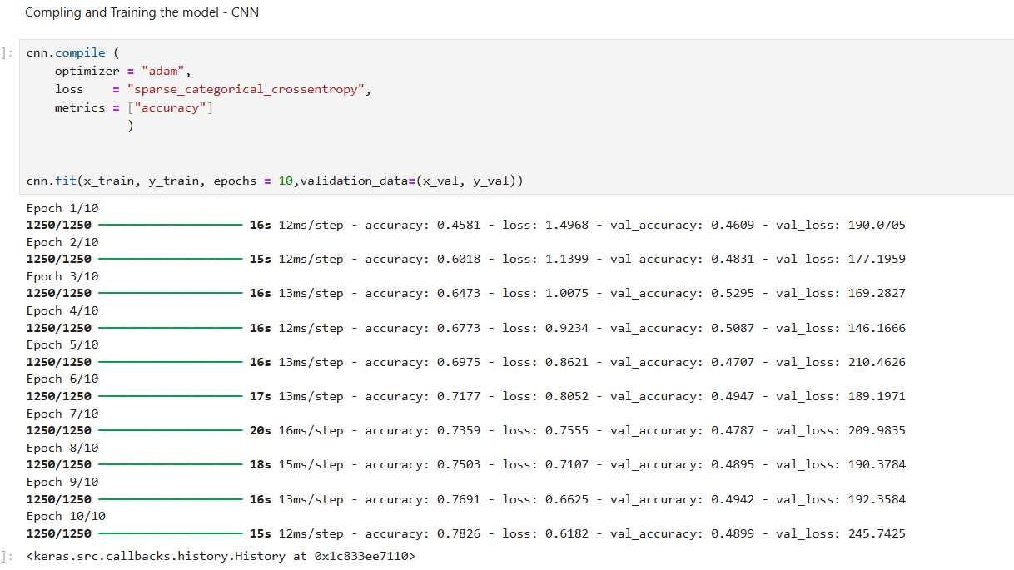
Accuracy with CNN

Slide 26
References
A Deep Learning Approach Using CNN and LSTM Network, (2023). 3rd International Conference on Pervasive Computing and Social Networking (ICPCSN), pp.343-348. (Accessed: 1 September 2025).
Lecun, Bottou, Bengio, Haffner (1998). Gradient-based learning applied to document recognition. Proceedings of the IEEE, 86(11), 2278-2324. (Accessed: 2 September 2025).
Scherer, Muller, Behnke: (2010) Evaluation of Pooling Operations in Convolutional Architecture for Object Recognition. Available at: http://www.ais.uni-bonn.de. (Accessed: 14 September 2025).
CNN Architectures: LeNet, AlexNet, VGG, GoogLeNet, ResNet and more - https://medium.com/@sidereal/cnns-architectures-lenet-alexnet-vgg-googlenet-resnet-and-more-666091488df5 . (Accessed: 17 September 2025).
Guo, Dong, Gao. Simple convolutional neural network on image classification. In Proceedings of the 2017 IEEE 2nd International Conference on Big Data Analysis (ICBDA), Beijing, China, 10–12 March 2017;pp. 721–724. (Accessed: 1 September 2025).
Sharma, Jain, Mishra. (2018).An analysis of convolutional neural networks for image classification. Procedia Comput. Sci., 132, 377–384. (Accessed: 20 September 2025).
Tu, Yin, S.; Ouyang, P.; Tang, S.; Liu, L.; Wei, S. Deep convolutional neural network architecture with reconfigurable computation patterns. IEEE Trans. Very Large Scale Integr. (Vlsi) Syst. 2017, 25, 2220–2233. (Accessed: 21 September 2025).
Ren, Y.; Cheng, X. Review of convolutional neural network optimization and training in image processing. In Proceedings of the Tenth International Symposium on Precision Engineering Measurements and Instrumentation, SPIE, Kunming, China, 8–10 August 2018; Volume 11053, pp. 788–797(Accessed: 27 September 2025).

Slide 27
Data Augmentation
It can enhance the diversity of your training dataset without collecting new data
Addresses overfitting

